Slide 1
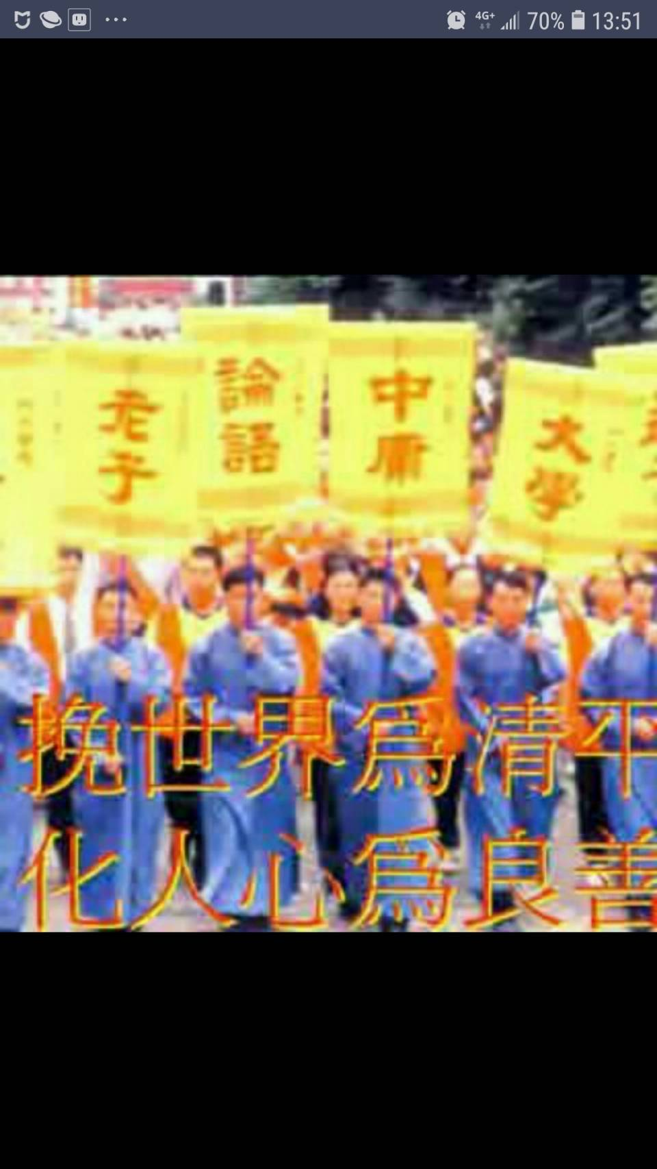
春暉英語讀經班教材
自我複習電子檔(附聲音檔)
西方文化導讀 第三冊 Lesson 5
By Hung Mark
2019.6.14 Fri
Copyright

Slide 2
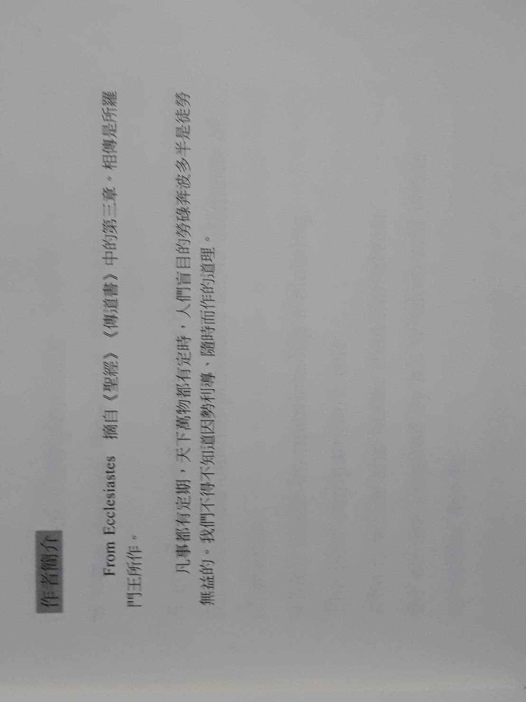


About The Author 有關作者

Slide 3

LESSON 5 For Everything There is a Season
From the Bible (Ecclesiastes 三, 1-8)
點擊喇叭可以撥放課文,並可以跳頁繼續聽!
For everything there is a season,
And a time for every purpose under the heaven,
A time to be born, and a time to die;
A time to plant, and a time to pluck up that which is planted;
A time to kill,and a time to heal;

Slide 4
LESSON 5 For Everything There is a Season
From the Bible (Ecclesiastes 三, 1-8)
A time to break down, and a time to build up
A time to weep, and a time to laugh;
A time to mourn, and a time to dance;
A time to cast away stones, and a time to gather stones together;
A time to embrace, and a time to refrain from embracing,

Slide 5
LESSON 5 For Everything There is a Season
From the Bible (Ecclesiastes 三, 1-8)
A time to get, and a time to lose;
A time to keep, and a time to cast away;
A time to rend, and a time to sew;
A time to keep silence, and a time to speak;
A time to love, and a time to hate;
A time of war, and a time of peace.

Slide 6
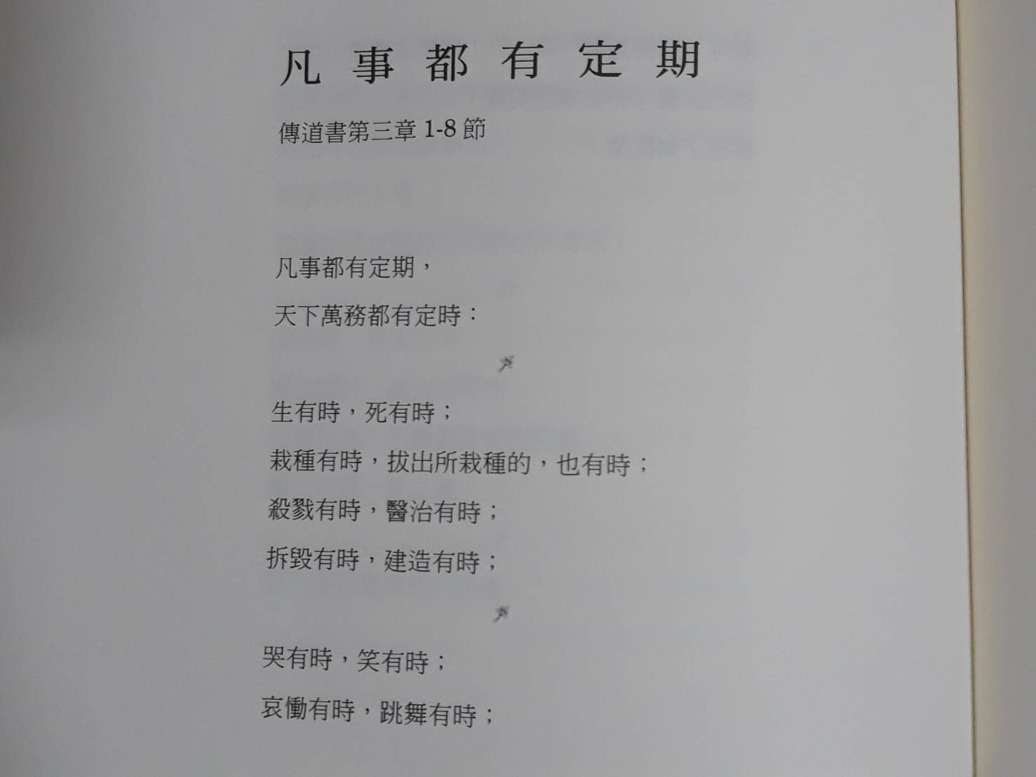
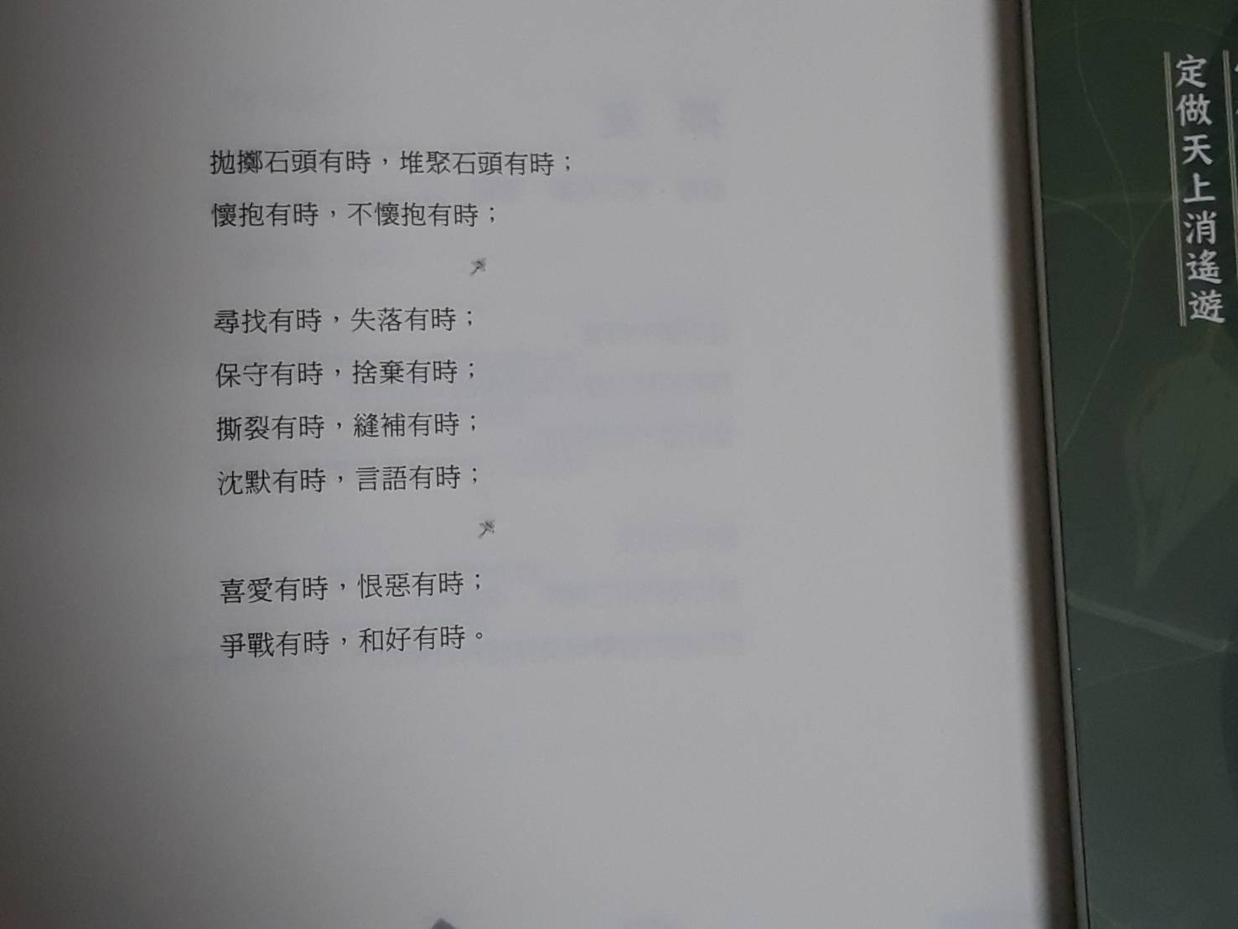
中文翻譯

