Slide 1

春輝英語讀經班教材
自我複習電子檔(附聲音檔)
西方文化導讀 第三冊 Lesson 7
By Hung Mark
2019.10.22 Thu
Copyright

Slide 2
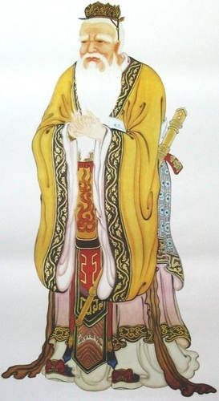
至聖先師 孔子聖像
有教無類
因才施教

Slide 3
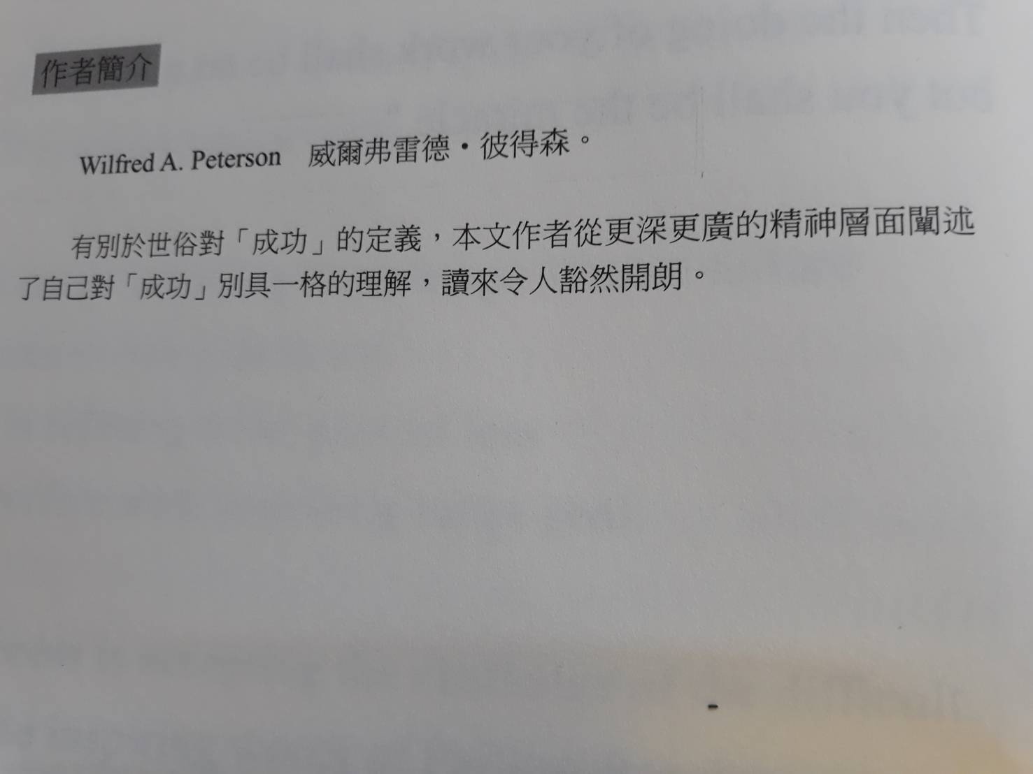


About The Author 有關作者

Slide 4

LESSON 7 Success
By Wilfred A. Peterson
點擊喇叭可以撥放課文,並可以跳頁繼續聽!
There are no secrets of success,
Success is doing the things you know you should do.
Success is not doing the things you know you should not do.
Success is not limited to any one area of your life.
It encompasses all the facets of your relationships:
as parent, as wife or husband,
as citizen, neighbor, worker, and all of the others.

Slide 5
LESSON 7 Success
By Wilfred A. Peterson
Success is not confined to any one part of your
personality
but is related to the development of all the parts:
body, mind, heart and spirit.
It is making the most of your total self.
Success is discovering your best talents, skills, and
abilities
and applying them where
they will make the most effective contribution
to your fellow men.

Slide 6
LESSON 7 Success
By Wilfred A. Peterson
Success is focusing the full power of all you are
on what you have a burning desire to achieve.
Success is ninety-nine percent mental attitude.
It calls for love, joy, optimism, confidence, serenity,
poise, faith, courage, cheerfulness, imagination,
initiative, tolerance, honesty, humility,
patience, and enthusiasm.
Success is not arriving at the summit of a mountain
as a final destination.

Slide 7
LESSON 7 Success
By Wilfred A. Peterson
It is a continuing upward spirit of prograss
It is a perpetual growth.
Success is having the courage to meet failure
without being defeated.
It is refusing to let present loss
interfere with your long-range goal.
Success is accepting the challenge of the difficult.
In the inspiring words of Phillips Brooks:
“Do not pray for tasks equal to your powers.
Pray for powers equal to your tasks.

Slide 8
LESSON 7 Success
By Wilfred A. Peterson
Then the doing of your work shall be no miracle,
but you shall be the miracle.”

Slide 9
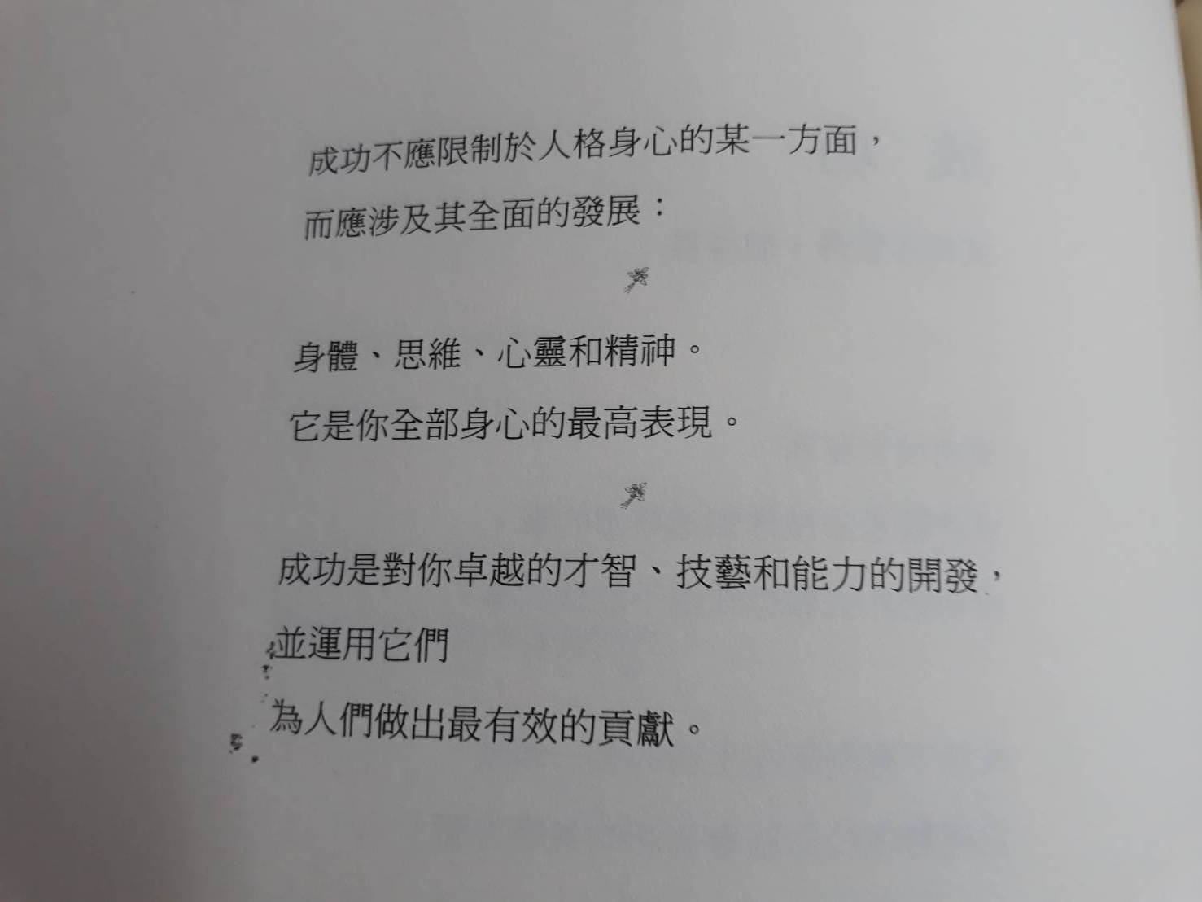
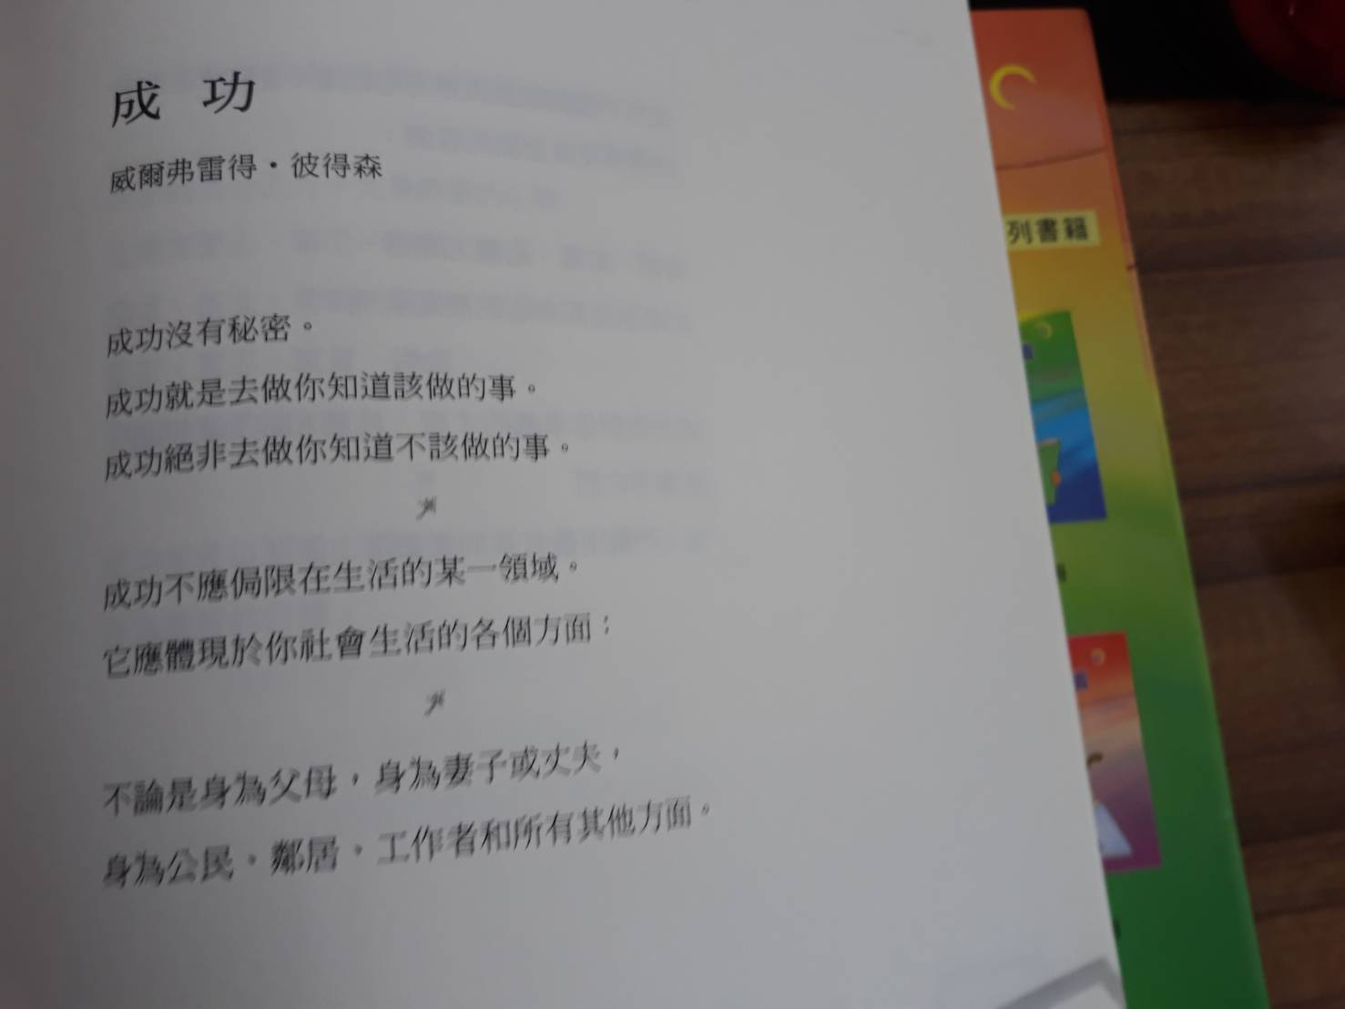
中文翻譯

Slide 10
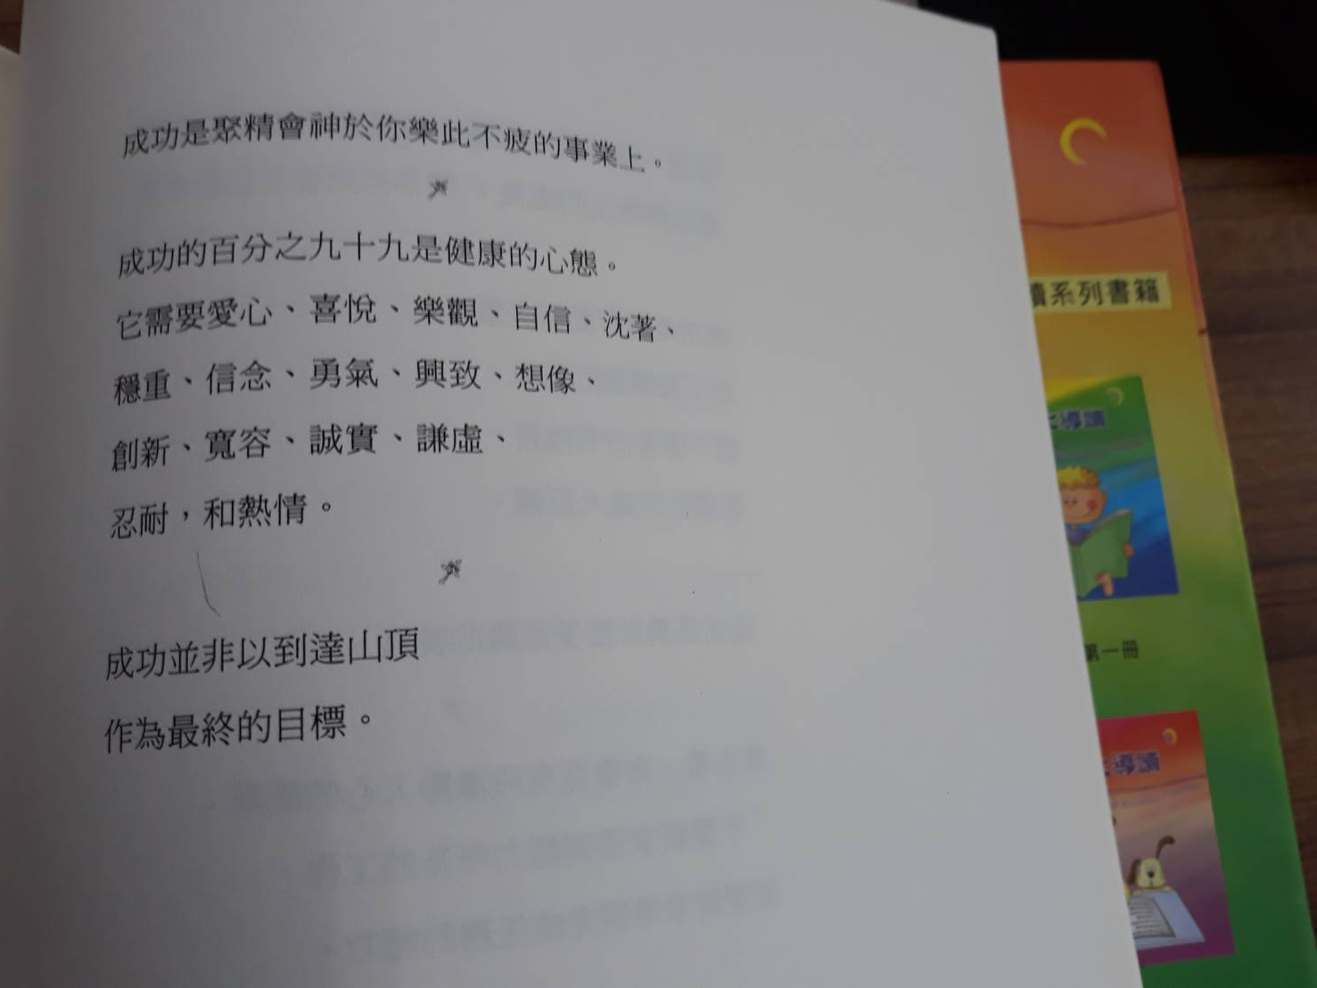
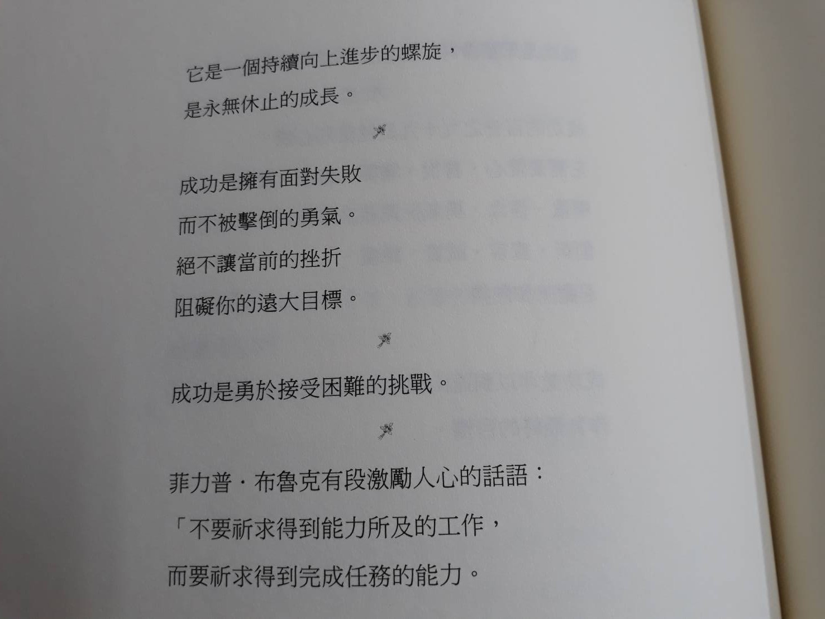
中文翻譯

Slide 11
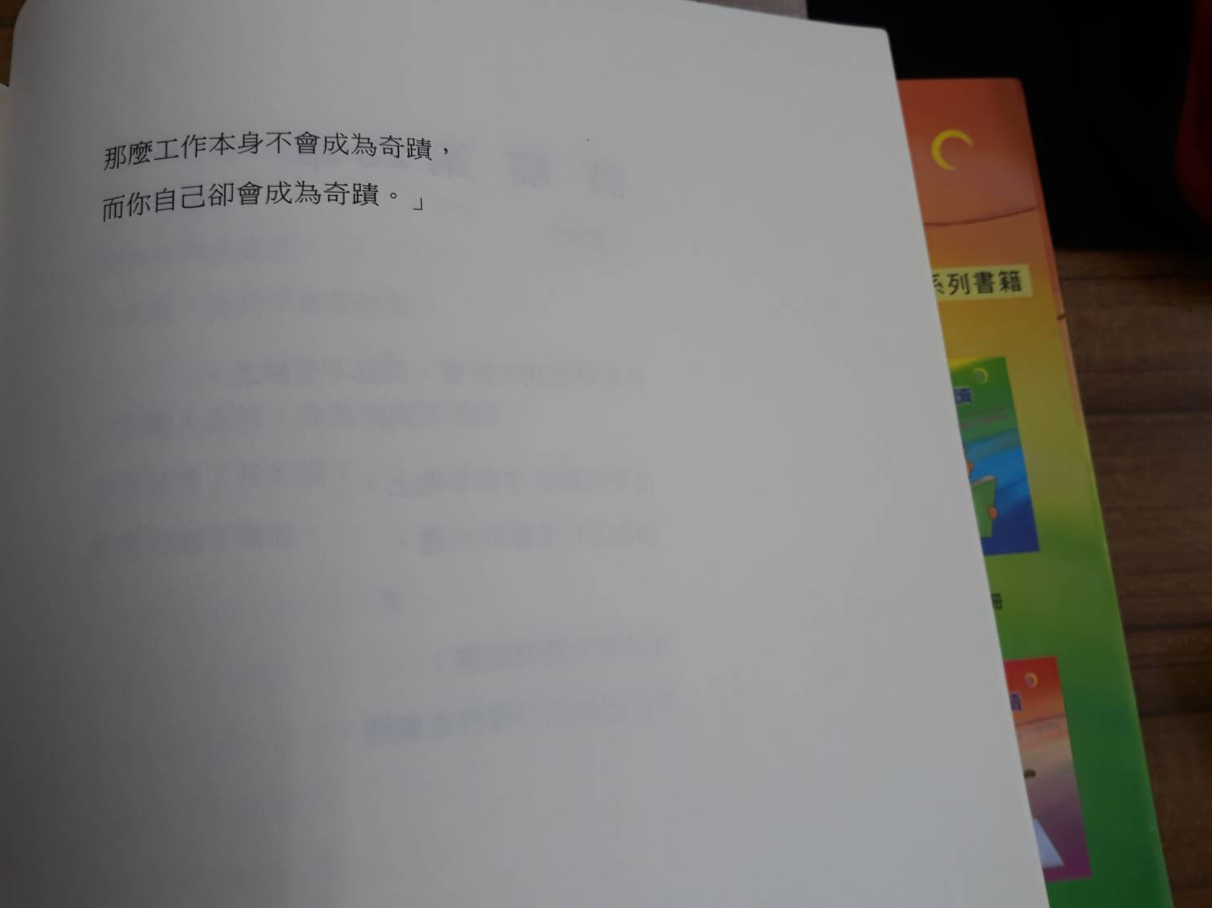
中文翻譯

