Slide 1
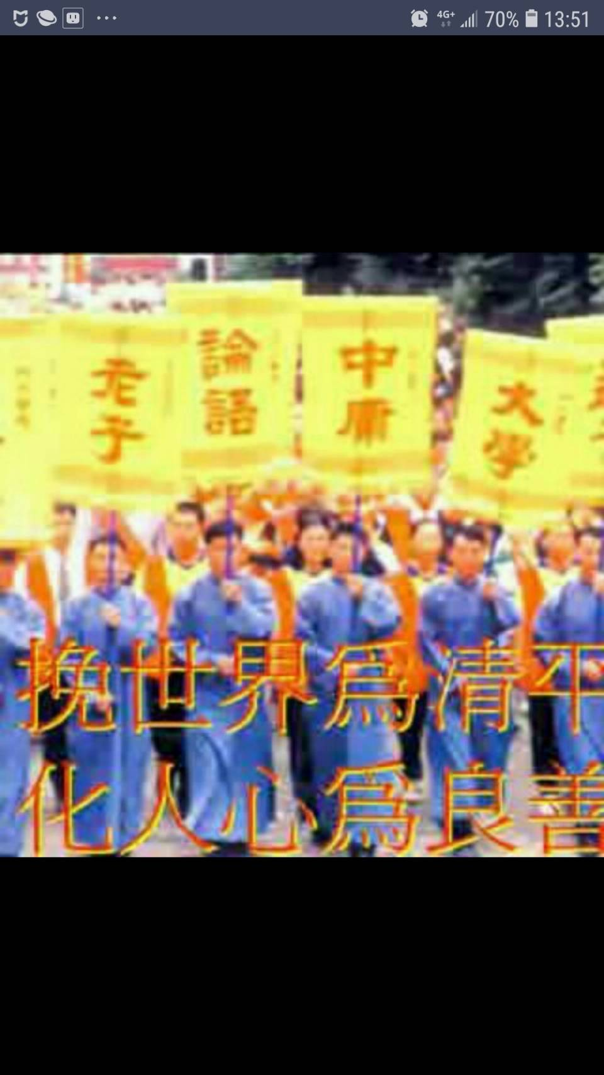
春輝英語讀經班教材
自我複習電子檔(附聲音檔)
西方文化導讀 第三冊 Lesson 6
By Hung Mark
2019.8.15 Thu
Copyright

Slide 2
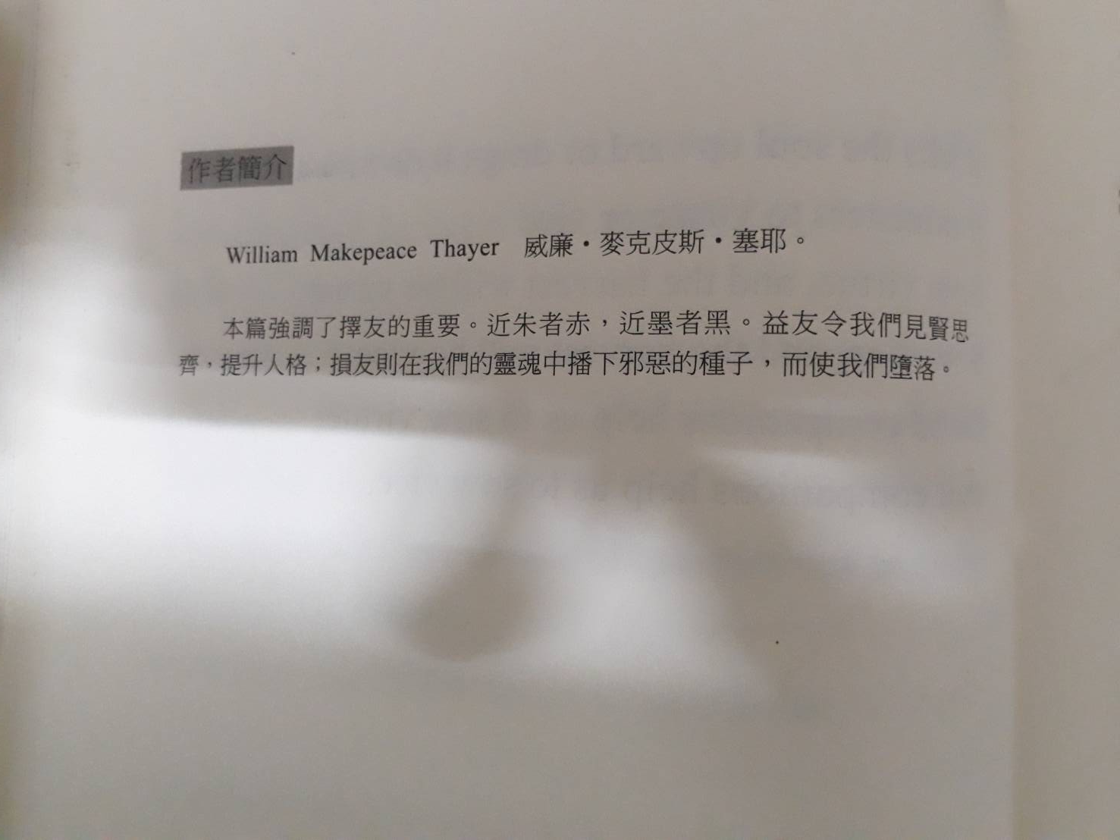


About The Author 有關作者

Slide 3

LESSON 6 Choice of Companions
By William Makepeace Thayer
點擊喇叭可以撥放課文,並可以跳頁繼續聽!
A good companion is better than fortune,
for a fortune cannot purchase those elements of character
which make companionship a blessing.
The best companion is one
who is wiser and better than ourselves,
for we are inspired by his wisdom and virtue
to nobler deeds.

Slide 4
LESSON 6 Choice of Companions
By William Makepeace Thayer
“Keep good company,
and you shall be one of the number,”
Said George Herbert.
“A man is known by the compay he keeps.”
Character makes character in the associations of life
faster than any thing else.
This fact makes the choice of companions in early
life more important
even than that of teachers and guardians.

Slide 5
LESSON 6 Choice of Companions
By William Makepeace Thayer
Companionship is education, good or bad;
it develops manhood or womanhood, high or low;
it lifts the soul upward or drags it downward;
it ministers to virtue or vice.
Sow virtue, and the harvest will be virtue.
Sow vice, and the harvest will be vice.
Good companions help us to sow virtue;
Evil companions help us to sow vice.

Slide 6
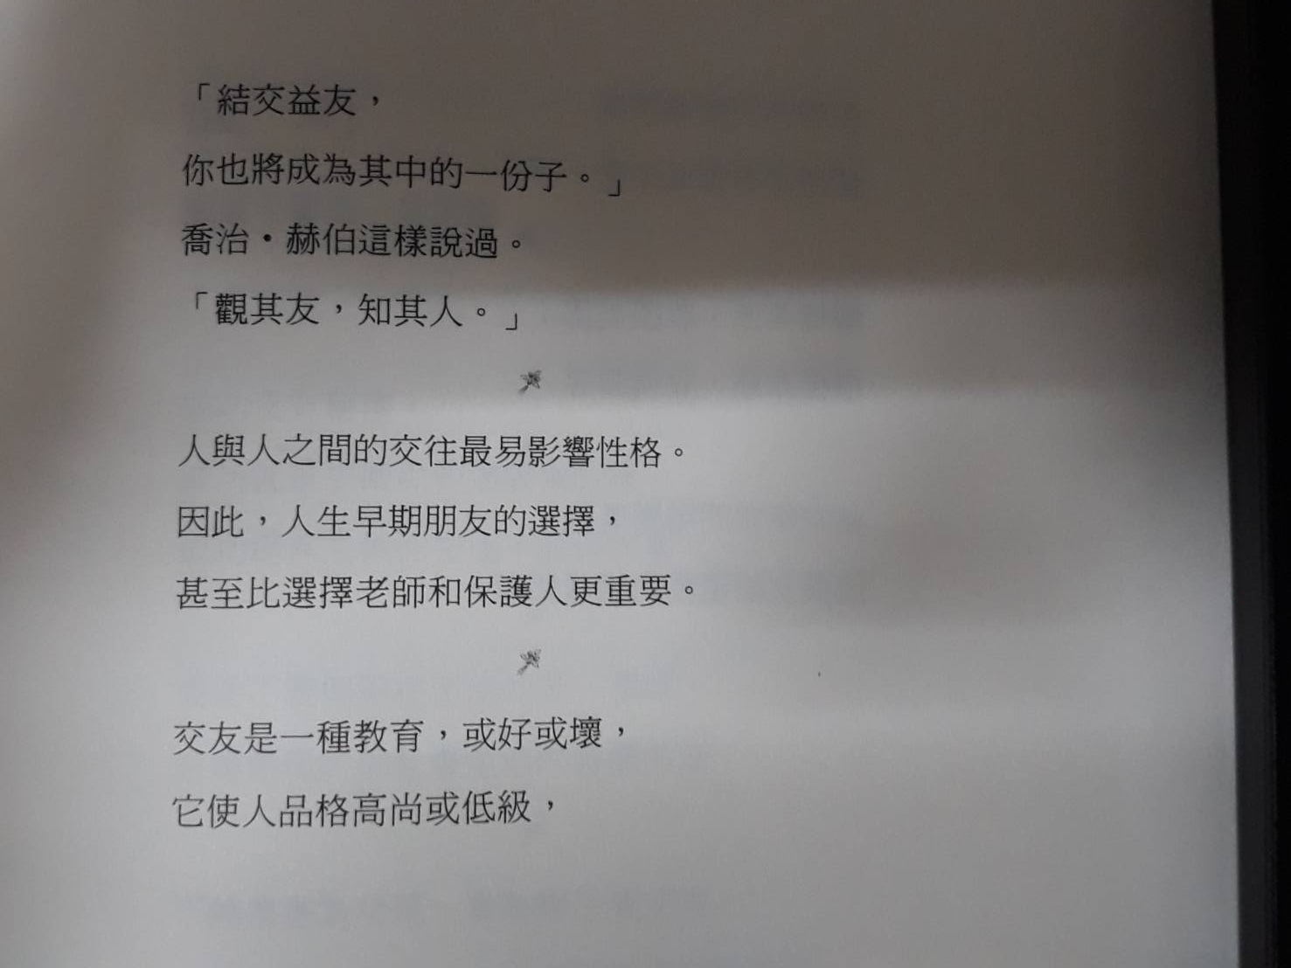
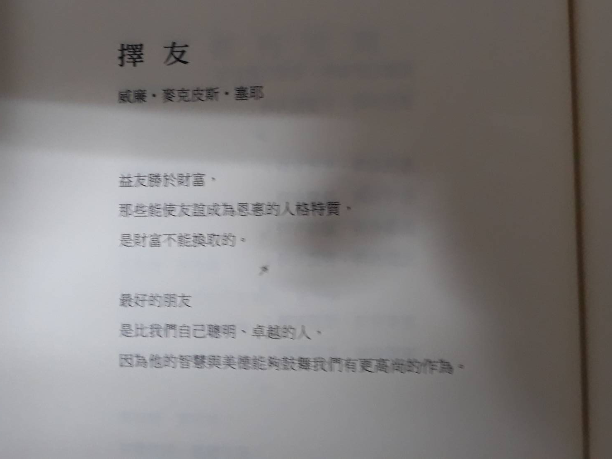
中文翻譯

Slide 7
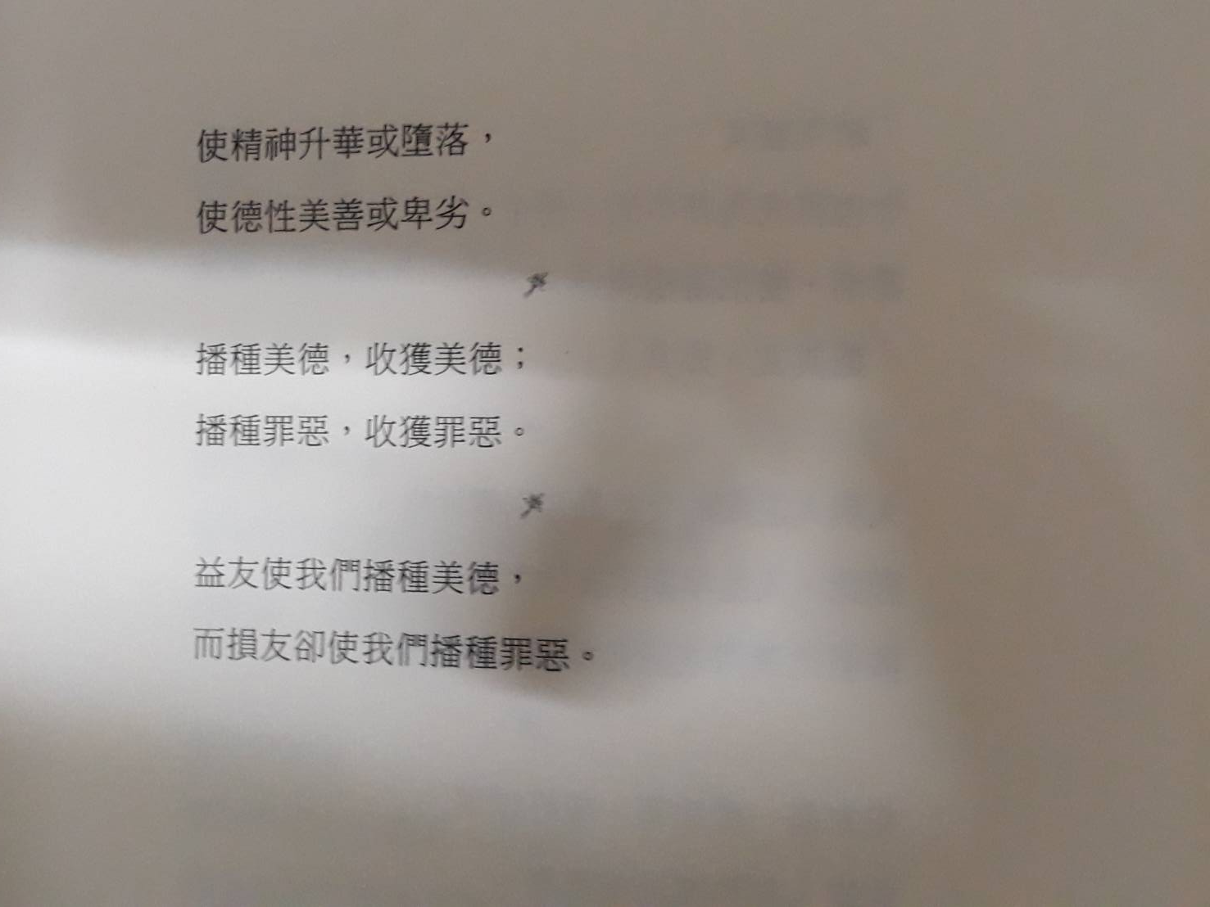
中文翻譯

